Slide 1

Networking
AWS Essentials
SoftUni Team
Technical Trainers
Software University
https://softuni.org

Slide 2
Table of Contents
Networking 101
Conceptual overview of VPCs
Internet Gateway and Route Tables
VPC Subnets, Security Groups and NACLs
Hans-On Lab

Slide 3
Have a Question?
sli.do
#AWS-essentials

Slide 4

Networking 101

Slide 5
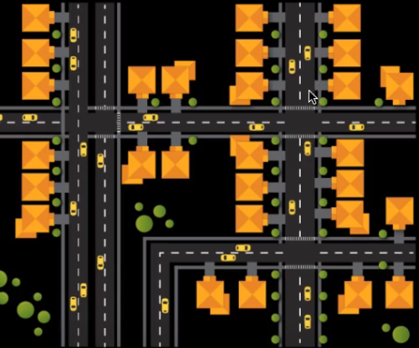
Comparing Networks to Neighborhoods

Slide 6
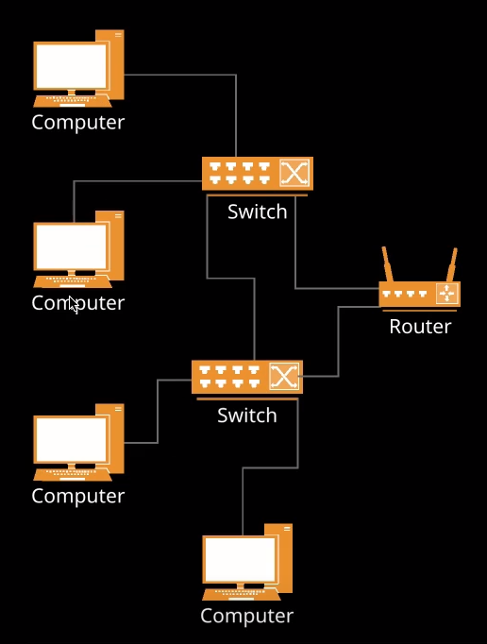
Network Diagram

Slide 7

Conceptual Overview of VPCs

Slide 8
What is a VPC ?
Amazon Definition:
Amazon Virtual Private Cloud lets you provision logically isolated section of the AWS cloud, where you can launch AWS resources in a virtual network that you define
You have complete control of your virtual networking environment

Slide 9
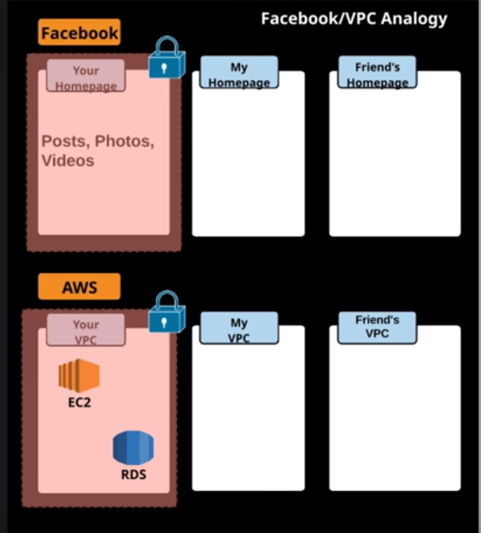
Facebook/VPC Analogy

Slide 10
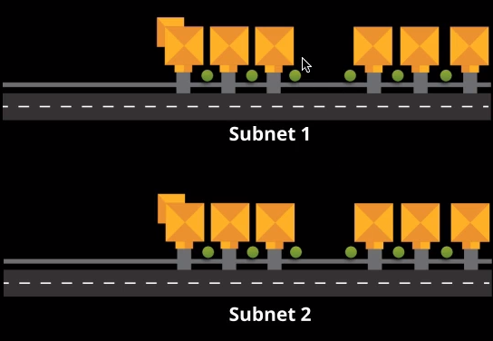
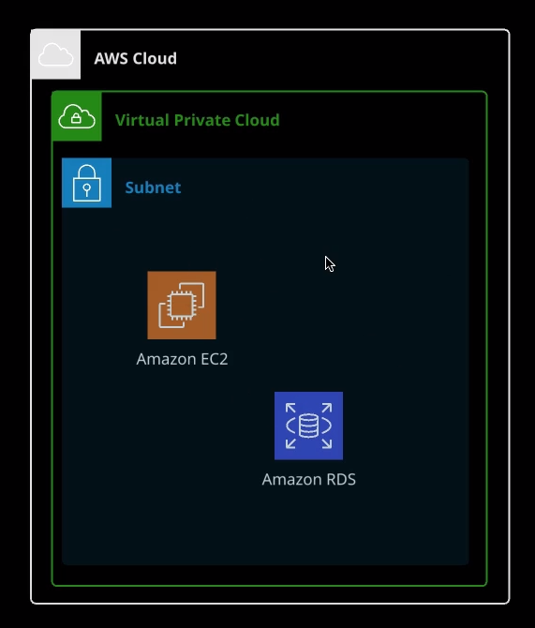
Subnets
A subnet is a subsection of a network
Generally subnet includes all of the computers in a specific location

Slide 11

Internet Gateways and Route Tables

Slide 12
Internet Gateways (IGWs)
An Internet Gateway is horizontally scaled, redundant and highly available VPC component
Allows communication between instances in your VPC and the internet
Imposes no availability risks or bandwidth constraints on your network traffic

Slide 13
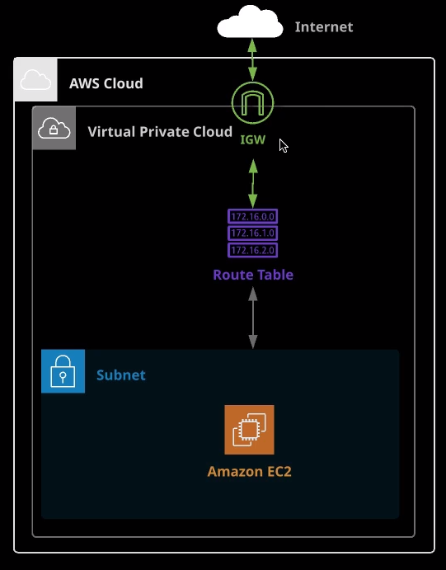
Diagram

Slide 14
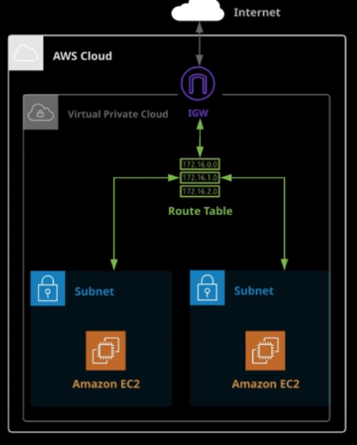
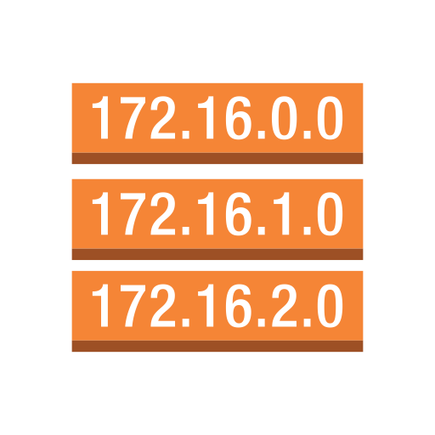
Route Tables
A Route Table contains a set of rules, called routes, that areused to determine when network trafic is directed

Slide 15
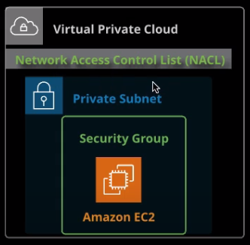
Networking Security
Network Access Control List (NACL)
A firewall/security layer on subnet level
Security Group
A firewall/security layer on instance/server level

Slide 16
Route 53
Highly available and scalable cloud Domain Name System (DNS) web service.
Amazon Route 53 Traffic Flow routes traffic based on multiple criteria, such as endpoint health, geographic location, and latency.
Amazon Route 53 is designed to work well with other AWS features and offerings. You can use Amazon Route 53 to map domain names to your Amazon EC2 instances, Amazon S3 buckets, Amazon CloudFront distributions, and other AWS resources.

Slide 17

VPC Workshop

Slide 18
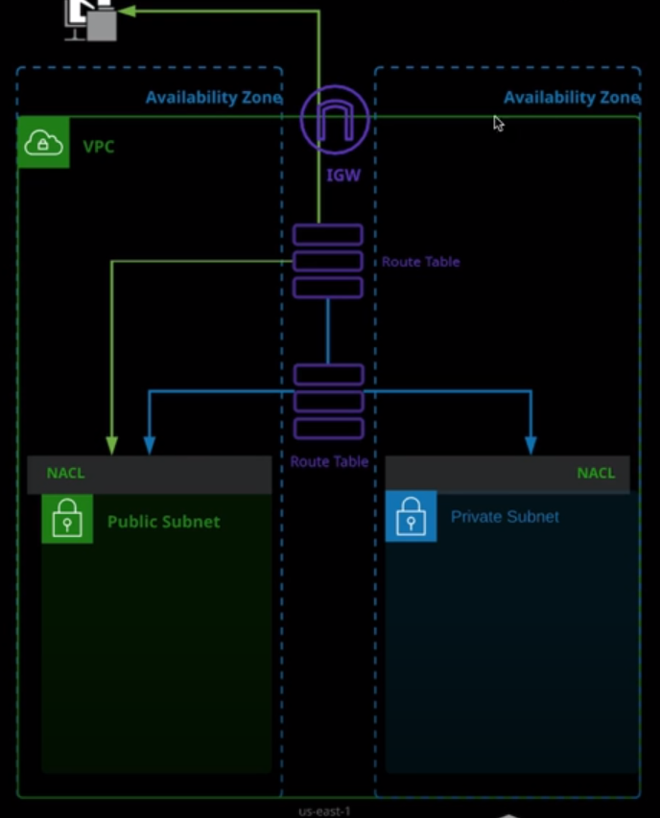
Workshop Diagram

Slide 19
Create VPC (1)
Create a VPC from scratch (without using the VPC Wizard).
Set the VPC CIDR to 172.16.0.0/16
Create a public and private subnet in different Availability Zones using the following IP CIDR addresses:
Public1 subnet in us-east-1a: 172.16.1.0/24
Private1 subnet in us-east-1b: 172.16.2.0/24

Slide 20
Create VPC (2)
Create Two Network Access Control Lists (NACLs), and Associate Each with the Proper Subnet
Create a public NACL with inbound rules allowing HTTP and SSH traffic, as well as an outbound rule allowing traffic on port range 1024-65535
Associate the public NACL with the public subnet
Create a private NACL with an inbound rule allowing SSH traffic with a source of 172.16.1.0/24, as well as an outbound rule allowing traffic on port range 1024-65535
Associate the private NACL with the private subnet

Slide 21
Create VPC (3)
Create an internet gateway, and connect it to the VPC
Create Two Route Tables, and Associate Them with the Correct Subnet
Create two route tables:
One for the public subnet with an internet gateway route
One for the private subnet without an internet gateway route
For the public route table, create a default route to the internet using the 0.0.0.0/0 CIDR notation

Slide 22

Summary
…
…
…
Networking 101
Conceptual overview of VPCs
Internet Gateway and Route Tables
VPC Subnets, Security Groups and NACLs
Hans-On Lab

Slide 23
Questions?

Slide 24











SoftUni Diamond Partners

Slide 25



Educational Partners

Slide 26
Trainings @ Software University (SoftUni)
Software University – High-Quality Education, Profession and Job for Software Developers
softuni.bg, about.softuni.bg
Software University Foundation
softuni.foundation
Software University @ Facebook
facebook.com/SoftwareUniversity
Software University Forums
forum.softuni.bg

Slide 27

License
This course (slides, examples, demos, exercises, homework, documents, videos and other assets) is copyrighted content
Unauthorized copy, reproduction or use is illegal
© SoftUni – https://about.softuni.bg/
© Software University – https://softuni.bg

